Slide 1
Lab 4
Monte-Carlo methods

Slide 2
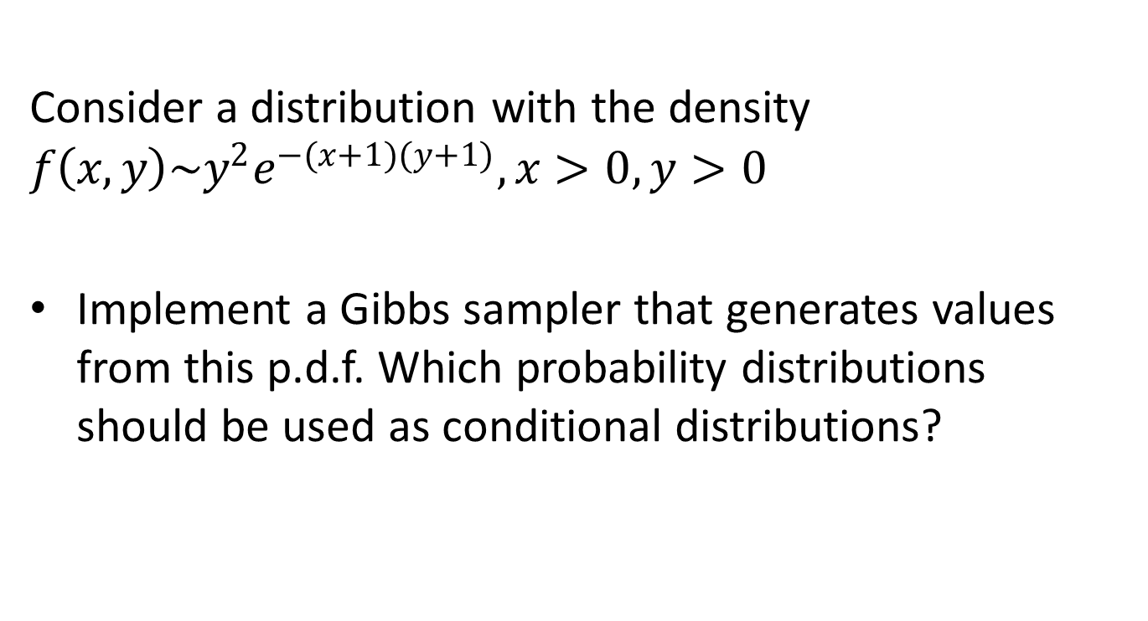
Assignment 1
Consider a distribution with the density $f\left(x,y\right)\sim y^{2}e^{−(x+1)(y+1)}, x>0,y>0$
Implement a Gibbs sampler that generates values from this p.d.f. Which probability distributions should be used as conditional distributions?

Slide 3
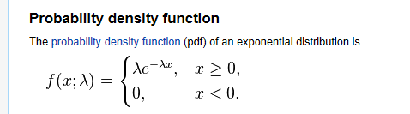

Assignment 1
Conditional distribution
$$f\left(x | y=3\right)∝3^{2}e^{−\left(x+1\right)\left(3+1\right)}∝e^{−\left(3+1\right)x}$$
Wikipedia
We have X|Y ~Exp(y+1)

Slide 4
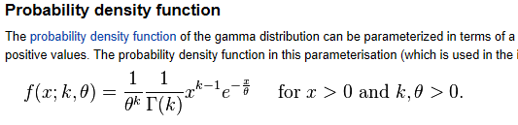

Assignment 1
Conditional distributions
$$f\left(y | x=3\right)∝y^{2}e^{−\left(3+1\right)y}$$
$k=3, θ=\frac{1}{x+1}$

Slide 5
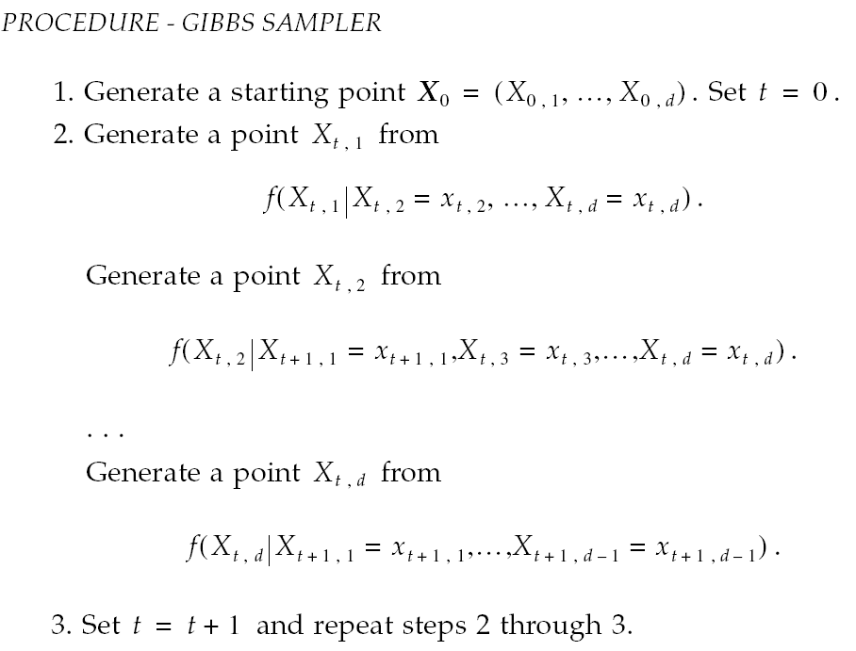
Gibbs sampler
Another way to generate multivariate random numbers
Uses conditional distributions → need random number generators that sample from univariate distributions

Slide 6
Assignment 1
Run this algorithm for two different starting points and create time series plots for the obtained x and y. Do the chains seem to converge? Motivate your answer.
#starting point
x=100
y=100
v=matrix(nrow=1000,ncol=2)
for (i in 1:1000) {
x=rexp(1,y+1)
y=rgamma(1,3,1/(x+1))
v[i,1]=x
v[i,2]=y
}
plot(v[,1], type=”l", col="red")
plot(v[,2], type=”l", col="blue")

Slide 7
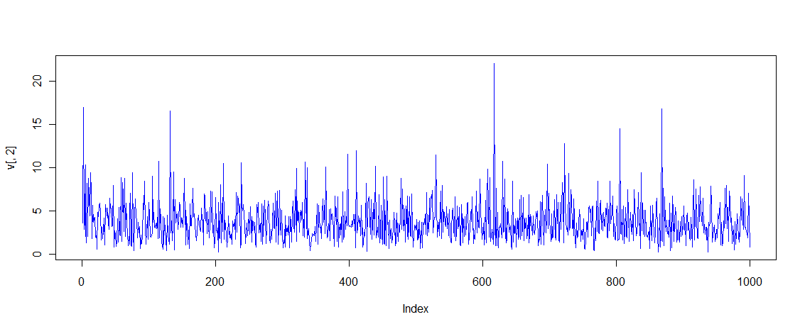
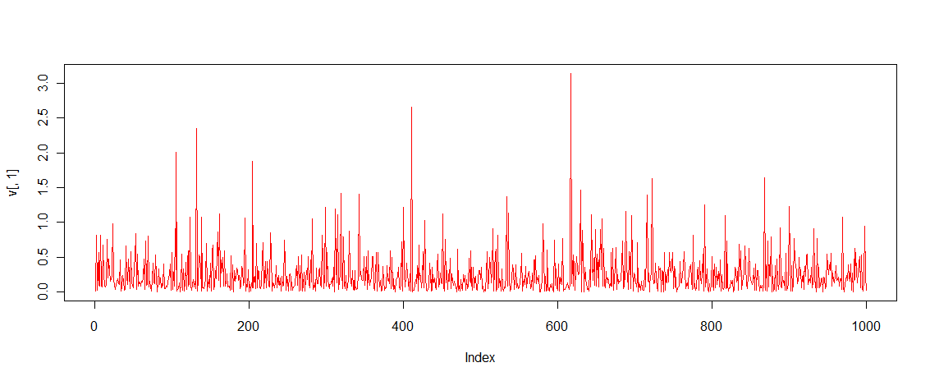
Assignment 1

Slide 8
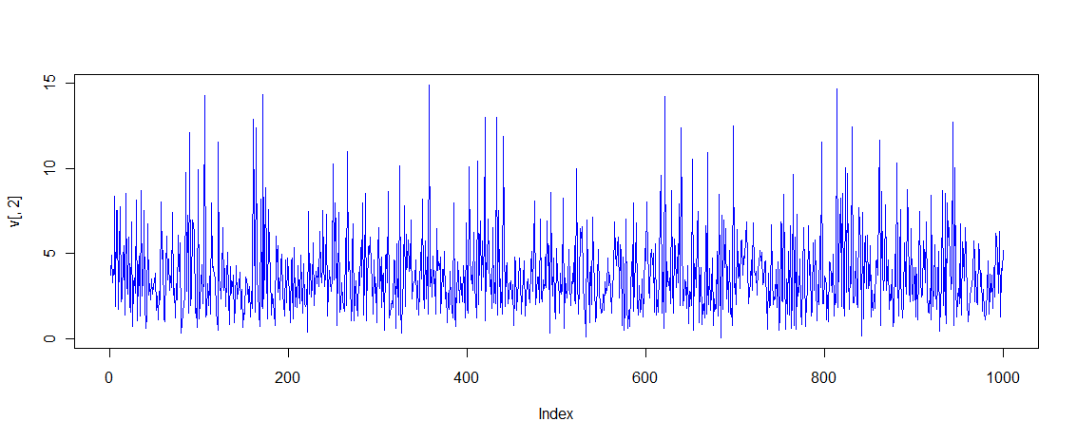
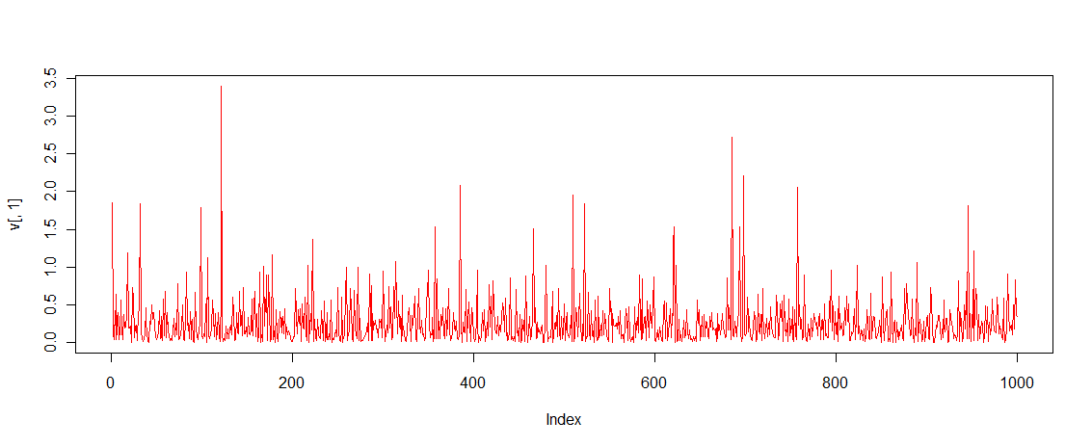
Assignment 1
x=3000
y=1

Slide 9
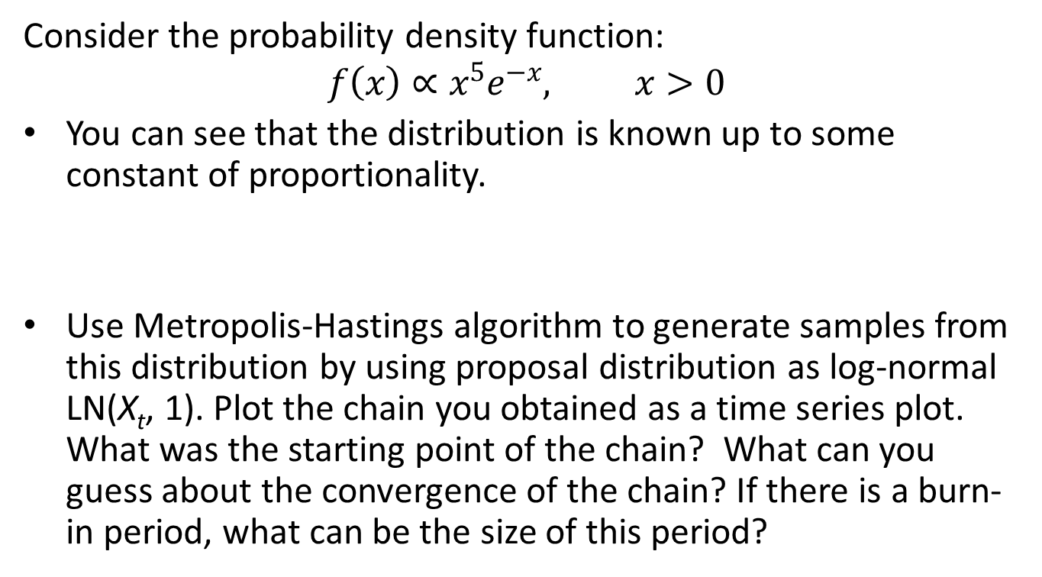
Assignment 2
Consider the probability density function:
$$f\left(x\right)∝x^{5}e^{−x}, x>0$$
You can see that the distribution is known up to some constant of proportionality.
Use Metropolis-Hastings algorithm to generate samples from this distribution by using proposal distribution as log-normal LN(X_{t}, 1). Plot the chain you obtained as a time series plot. What was the starting point of the chain? What can you guess about the convergence of the chain? If there is a burn-in period, what can be the size of this period?

Slide 10
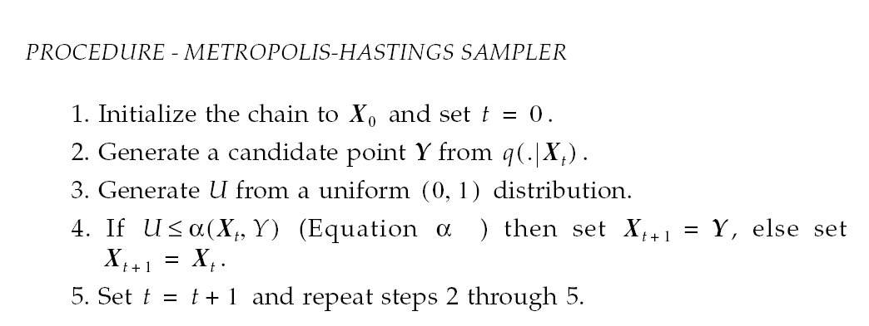
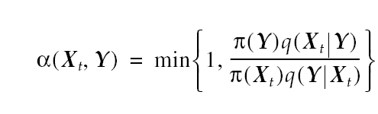
Metropolis-Hastings algorithm
Equation α:

Slide 11
Assignment 2
Code
pf<-function(x) exp(-x+5*log(x));
x<-c();
#note! Values are given on log-scale
x[1]<-log(3);
r<-0;
y<-0;
for(i in 1:1000) {
y<-rlnorm(1,x[i],1);
r<-min(1,pf(y)*dlnorm(x[i],y,1)/(pf(x[i])*dlnorm(y,x[i],1)));
if (u<=r) x[i+1]<-y else x[i+1]<-x[i];
}
plot(x, type="l")
title("X0=3")
One could have used dlnorm(x[i],log(y),1)→ totally different results

Slide 12
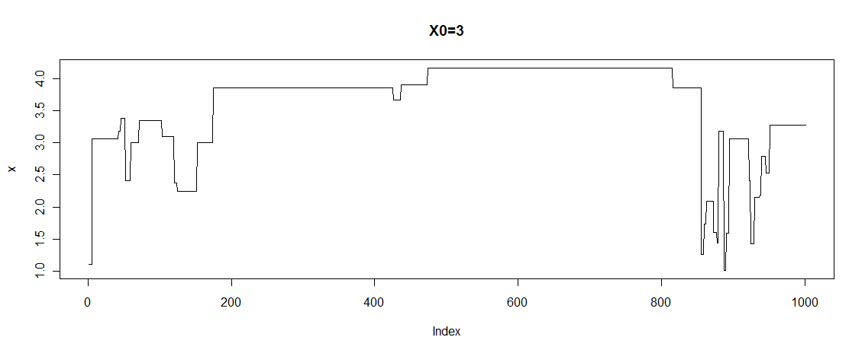
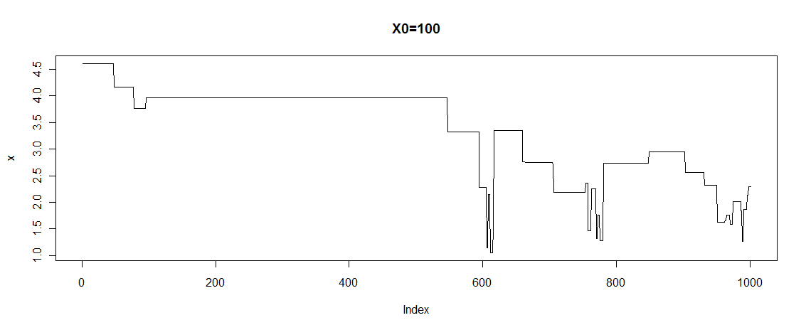
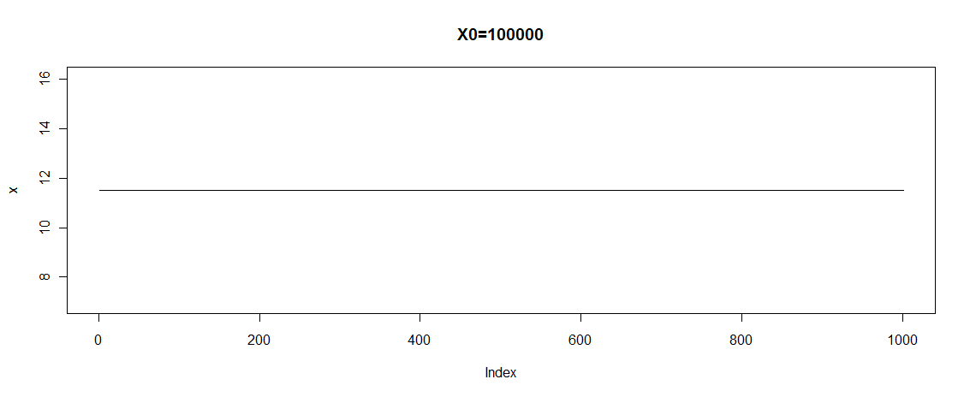
Mu is too large compared to sigma.

Slide 13

Assignment 2
Perform step 1 using proposal distribution as chi-square distribution $χ^{2}\left(floor(X_{t}+1)\right)$ where floor(x) means integer part of x.
pf<-function(x) exp(-x+5*log(x));
x<-c();
x[1]<-1;
r<-0;
y<-0;
for(i in 1:2000) {
y<-rchisq(1,floor(x[i]+1));
r<- min(1,pf(y)*dchisq(x[i],floor(y+1))/(pf(x[i])*dchisq(y,floor(x[i]+1))));
if (u<=r) x[i+1]<-y else x[i+1]<-x[i];
}
plot(x, type="l")

Slide 14
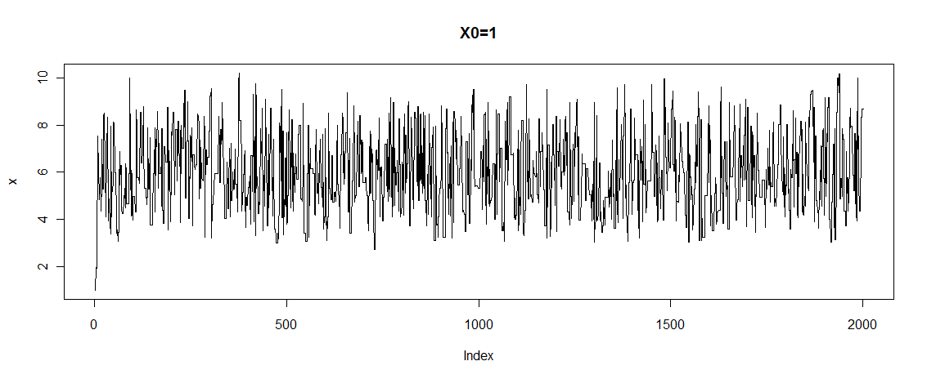
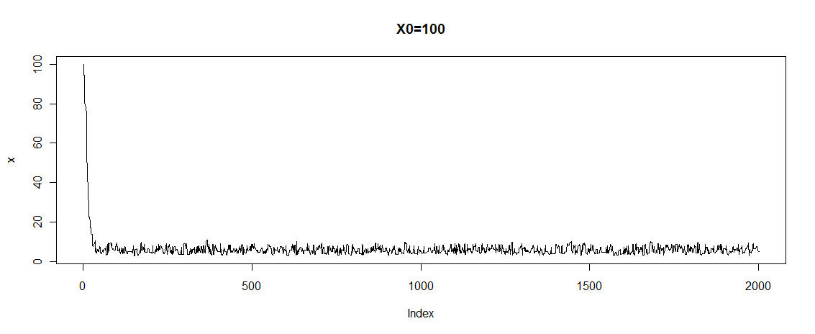
Compare the results of steps 1 and 2 and make conclusions.

Slide 15
Assignment 2
Generate 10 MCMC sequences using the generator from the step 2 and with starting points 1,2,.., or 10. Implement and apply Gelman-Rubin method to these sequences and analyze whether the sequences converged.

Slide 16





Convergence monitoring
Gelman-Rubin method
Assume, we estimate ν(X)
Generate k sequences of length n with different starting points
Compute between- and within- sequence variances:
Compute overall variance estimate:
Compute Gelman-Rubin factor
If the factor is close to 1, i.e. around 1.0 - 1.2, then the convergence is achieved

Slide 17
Assignment 2
n<-2000
chigen<-function(start) {
pf<-function(x) exp(-x+5*log(x));
x<-c();
x[1]<-start;
r<-0;
y<-0;
for(i in 1:(n-1)) {
y<-rchisq(1,floor(x[i]+1));
r<-min(1,pf(y)*dchisq(x[i],floor(y+1))/(pf(x[i])*dchisq(y,floor(x[i]+1))));
if (u<=r) x[i+1]<-y else x[i+1]<-x[i];
}
return(x);
}

Slide 18

Assignment 2
v<-matrix(ncol=10, nrow=n,c(0));
for (s in 1:10) v[,s]<-chigen(s);
meanv<-apply(result, 2, mean)
meanT<-mean(meanv);
B<-n/9*sum((meanv-meanT)^2)
s2<-apply(result, 2, var)
W<-mean(s2)
varv=(n-1)/n*W+1/n*B
GR=sqrt(varv/W)

Slide 19
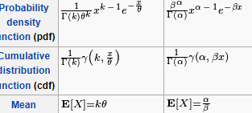

Assignment 2
Estimate $\int_{0}^{∞}{x∙f\left(x\right)dx}$ using the samples from steps 1 and 2.
The distribution generated is in fact a gamma distribution. Look in the literature and define the actual value of the integral. Compare it with the one you obtained.
print(mean(x[1000:2000]))
First case: [1] 3.629153
Second case:[1] 5.846186
EX=6

